Slide 1
IBM APPLIED DATA SCIENCE CAPSTONE COURSE BY COURSERA Start your shopping mall in Kochi, India
Start your shopping mall in Kochi, India
Submitted by: nikhila joshy

Slide 2
Introduction
The main reason shopping malls are so popular is that they are very convenient. Most of them include clothing stores, a food court, movie theatres, arcade rooms, and much more.
Moreover, many people prefer to meet up in a shopping mall, watch a movie and later have snacks in the food court.
Besides, with the decline of open places and parks, many families gather at a large shopping mall to enjoy their holidays.

Slide 3
Business Problem
Things to consider while starting a shopping mall:
Decide on the niche you would like to target. Usually if your target is teenagers and women below the age of 40 then make sure that the mall you open looks trendy.
If a particular franchise has strong customer base then the foot traffic will naturally increase and you will find people dropping in from different area as well.
Location plays a vital role in the business. Look for an area where there are no competitors around. If there are more malls in the locality you are planning to set your business, then competition will be high and profit will be less.
This project will take care of the making an informed decision about the location.

Slide 4
Data
1. Since the scope of this project is confined to the district of Kochi in Kerala, India, we need the list of all the neighbourhoods of Kochi.
The neighbourhood information will be scraped from the Wikipedia webpage https://en.wikipedia.org/wiki/Category:Suburbs_of_Kochi.
2. Latitude and longitude coordinates of those neighbourhoods to plot the map and to get venue details.
Geocoder package in python is used to get the coordinates of the neighbourhoods.
3. Venue data to perform clustering
Foursquare API will be exploited to get the venue details for all the neighbourhoods.

Slide 5
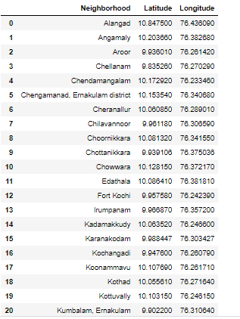
Methodology
1. Data extraction
and preparation

Slide 6
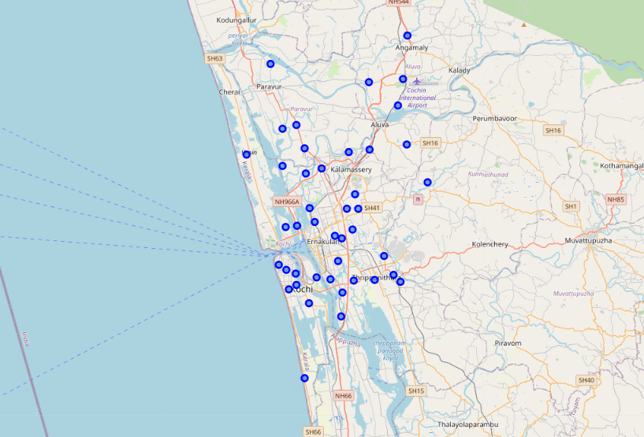
Geographical coordinates returned by Geocoder are correctly plotted in the city of Kochi.

Slide 7
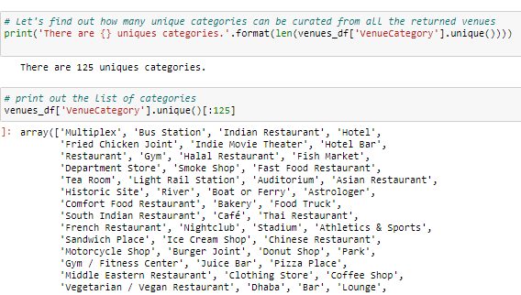
3. Foursquare API is used to get the top 100 venues that are within a radius of 2000 meters.

Slide 8
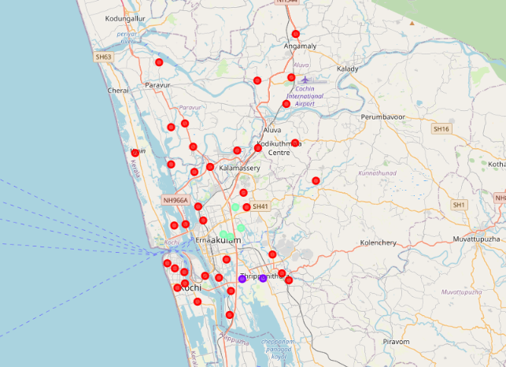
4. Perform clustering on the data by using k-means clustering by the similarity in the frequency of occurrence of each venue category.

Slide 9
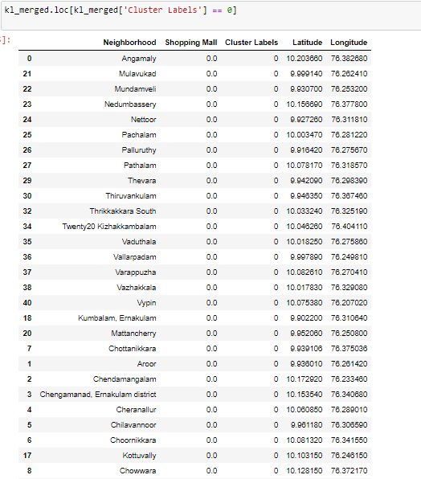
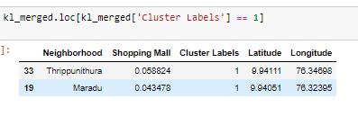
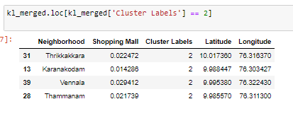
Results

Slide 10
Discussion
Shopping malls are concentrated in cluster 1 with almost as many shopping malls as cluster 1 in cluster 2 and none in cluster 0.
This shows that there is a lot of potential for shopping malls in areas that belong to cluster 0 because of the lack of competition and a need for a common destination point.
If a shopping mall is brought about in cluster 1 or cluster 2, it would suffer from the intense competition between the already existing shopping outlets and the upcoming ones.
Therefore, this project can be utilized by project architects to capitalize on these observations in building shopping malls in different neighbourhoods of Kochi.

Slide 11
Limitations and Suggestions for Future Research
We only consider one factor i.e. frequency of occurrence of shopping malls, there are other factors such as urbanization, population and income of residents that could influence the location decision of a new shopping mall.
In addition, this project made use of the free Sandbox Tier Account of Foursquare API that came with limitations as to the number of API calls and results returned.
This project can also be extended to find suitable locations to open a new restaurant, gym or universities.
It can also be reused to check for locations outside India by very little modification to the code.

Slide 12
Conclusion
In this project:
We specified the business problem definition
Identified the methodology to be used
Extracted and prepared the data
Performed K - means clustering algorithm
Drew inference from the results that were obtained.
This can be used by the relevant stakeholders to explore the best locations to open a new shopping mall. The findings of this project will help to capitalize on the opportunities on high potential locations while avoiding overcrowded areas and the competition that follows it.
It was found out from the above data that the neighbourhoods in cluster 0 are the most preferred locations to open a new shopping mall in Kochi, Kerala.

